Slide 1
Neural Machine Translation
USC VSoE CSCI 544: Applied Natural Language Processing
Jonathan May -- 梅約納
Nanyun (Violet) Peng -- 彭楠赟
November 7, 2018
Slides from Richard Socher, Abi See, Chris Olah, Philip Koehn

Slide 2
Pre-Neural Statistical MT (1989-2014)
Use EM to find word alignments of parallel sentences
Break sentences up into phrase pair chunks
Extract feature values for each chunk and optimize weights to maximize BLEU on development set
Problems:
Translations are often not that fluent (looks like a ransom note)
Which features to choose? How to combine?
Fairly complicated noisy pipeline

Slide 3
Not that Fluent...
Source : ප්‍රවාහන ගාස්තු ඉහළ නැංවීමට විරෝධය පළ කරමින් බ්‍රසීලයේ අද (07) විරෝධතා ක්‍රියාත්මක වුණා.
Ref0 : There were protests in Brazil today (07) due to price increases in transportation.
mt1 : Today (07), Brazil was to protest against the bus fare increase.
mt2 : Staged a protest against transport fares to increase in Brazil, launched a protest today (07th).
mt3 : Transport fare increase in Brazil to protest against the government today the implementation of the protests.

Slide 4
Features
N-gram language model (2 or more)
Phrase translation probabilities p(e|f) and p(f|e)
Word translation probabilities p(e|f) and p(f|e)
Number of Insertion/deletions (when phrases include unaligned words)
Number of phrases used
Length of hypothesis
Amount of jumping around
Lexical flag features (binary value for "sentence contains 'octopus'")

Slide 5
Pipeline
Word alignment
Phrase pair extraction
Feature Estimation
Parameter Estimation
Wrong alignment? Stuck!
Can only use the phrase pairs you extracted; can't arbitrarily generate words
What are the right features for this data set? (may vary from set to set)
Typically adjusted over a small set; hard to search
efficiently

Slide 6
Extremely brief sketch of parameter (weight) estimation
1
1
4
4
4
3
features
phrase pair | log(p1) | log(p2)
x<->a | 2 | -1
x<->b | 1 | 3
y<->c | 0 | 1
y<->d | -1 | 4
e<->z | 4 | 0
λ₁=1
λ₂=1

Slide 7
Change The Weights, Change The Search Space
-3
1
-4
-10
-4
-11
features
"so taking this step has a score of -11"
phrase pair | log(p1) | log(p2)
x<->a | 2 | -1
x<->b | 1 | 3
y<->c | 0 | 1
y<->d | -1 | 4
e<->z | 4 | 0
λ₁=-1
"but overall feature 1 contributes -1 to the score and feature 2 contributes -3 [note log though]"
λ₂=-3
"translating 'y' to 'd' has -1 value per feature 1 and 4 value per feature 2"

Slide 8
Problems
Are these the right features? Should we use combinations of features?
What if we made a mistake during alignment? We're locked into those possibilities even though we didn't make alignments to optimize mt quality.
We only have estimates for the things we've seen and based on limited context. It would be nice to generalize to unseen events and full context

Slide 9
New Approach
Interlingua
Transfer
How to get this?
Analysis (build representation)
Generation
(read off leaves)
Source
Target

Slide 10
Recall: Feature Engineering for WSD
𝛟(x)
w₁
w₂
3
bias | 1
capitalized? | 0 | -3.0 | -6/2
#wordsBefore | 6 | .22 | .15
#wordsAfter | 3 | -.01 | .03
relativeOffset | 0.66 | 1.00 | .85
leftWord=about | 1 | 0 | 0
leftWord=best | 0 | -2.0 | 3.0
rightWord=rates | 1 | 5.0 | -1.2
rightWord=in | 0 | -1 | -0.5
Wall | 1 | .8 | -.4
Street | 1 | 2.0 | .3
vets | 1 | ... | ...
best | 0
in | 0
Wall Street | 1
Street vets | 1
vets raise | 1
2.4
X = Wall Street vets raise concerns about interest rates , politics
less important
argmax_{c} w_{c}^{T}𝛟(x)
Important!
Choose whatever
weights make the classifier better

Slide 11
Can Do It For LMs Too!
𝛟(x)
w(x_{i}=bit)
w(x_{i}=bought)
bias | 1 | .95 | -3.2
x_{i-2}=apple | 0 | .436 | 33.6
x_{i-2}=dog | 0 | -34 | ...
x_{i-2}=cat | 0 | ... | ...
x_{i-2}=the | 1 | 3.4 | 3.6
... | ... | ... | ...
x_{i-1}=apple | 0 | ... | ...
x_{i-1}=dog | 0 | 14.4 | -5.6
x_{i-1}=cat | 1 | 6.3 | -7.8
x_{i-1}=the | 0 | -5 | -17
... |  | ... | ...
x_{i-2}=NOUN | 0 | ... | ...
x_{i-2}=DET | 1 | ... | ...
x_{i-1}=NOUN | 1 | ... | ...
x_{i-1}=DET | 0 | ... | ...
x_{i-2}=apple ^ X_{i-1}=the | 1 | ... | ...
 |  | ... | ...
P(bit | the cat) vs P(bought | the cat)
As before, we can add arbitrary features
POS tags
word length
initial letter
What about conjuncts of features (bigram+)?
Yes, but this will get very lengthy
Neural Idea: stacks of perceptrons with nonlinearity allow conjuncts for free

Slide 12
P(x|the students opened their)
Represents the 4-gram
Phrase "features"
No backoff!
No unseen sequences!
Word "features"

Slide 13
From LM to MT?
Why not predict the translation of "the students opened their" instead of the next word?
Problems:
No phrase-phrase data
Some phrases not translatable
How to reorder the translations?
Can we condition on the whole sentence at once?

Slide 15
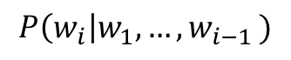
Recall: RNNs
$$P\left(w_{i}\right|w_{1}, {…,w}_{i−1})$$
w_{i-1}

Slide 16
h_{"I"}
P(w_{i}= ... | "I")
=P(w_{i}= ... | h_{"I"})
"I"
Sentence = "I threw the ball"

Slide 17
h_{"I threw"}
P(w_{i}= ... | I threw)
h_{"I"}
=P(w_{i}= ... | h_{"I threw"} )
"threw"
Sentence = "I threw the ball"

Slide 18
h_{"I threw the"}
P(w_{i}= ... | I threw the)
h_{"I threw"}
=P(w_{i}= ... | h_{"I threw the "} )
"the"
Sentence = "I threw the ball"

Slide 19
h_{"I threw the ball"}
P(w_{i}= ... | I threw the ball)
h_{"I threw the"}
=P(w_{i}= ... | h_{"I threw the ball "} )
P(w_{i}= STOP | I threw the ball)
"ball"
Sentence = "I threw the ball"

Slide 20
h_{"I threw the ball STOP"}
h_{"I threw the ball"}
This is a representation
of a sentence.
We can use it to condition a model for producing translations.
"STOP"
Does it capture syntax? Semantics? Everything?

Slide 21
New Approach
Interlingua
How to get here?
Transfer
We got this
Analysis (build representation)
Generation
(read off leaves)
Better yet, let's just go straight here (but still, how?)
Source
Target

Slide 22
How to use a sentence vector for machine translation
The vector is the product of an RNN (the encoder)
It can also be the input to another RNN (the decoder)
We'll train them together in what's called the sequence-to-sequence (seq2seq) or encoder-decoder (more generally) model

Slide 23
Extension: encoder often a bidirectional RNN (two RNNs working in opposite directions)

Slide 24
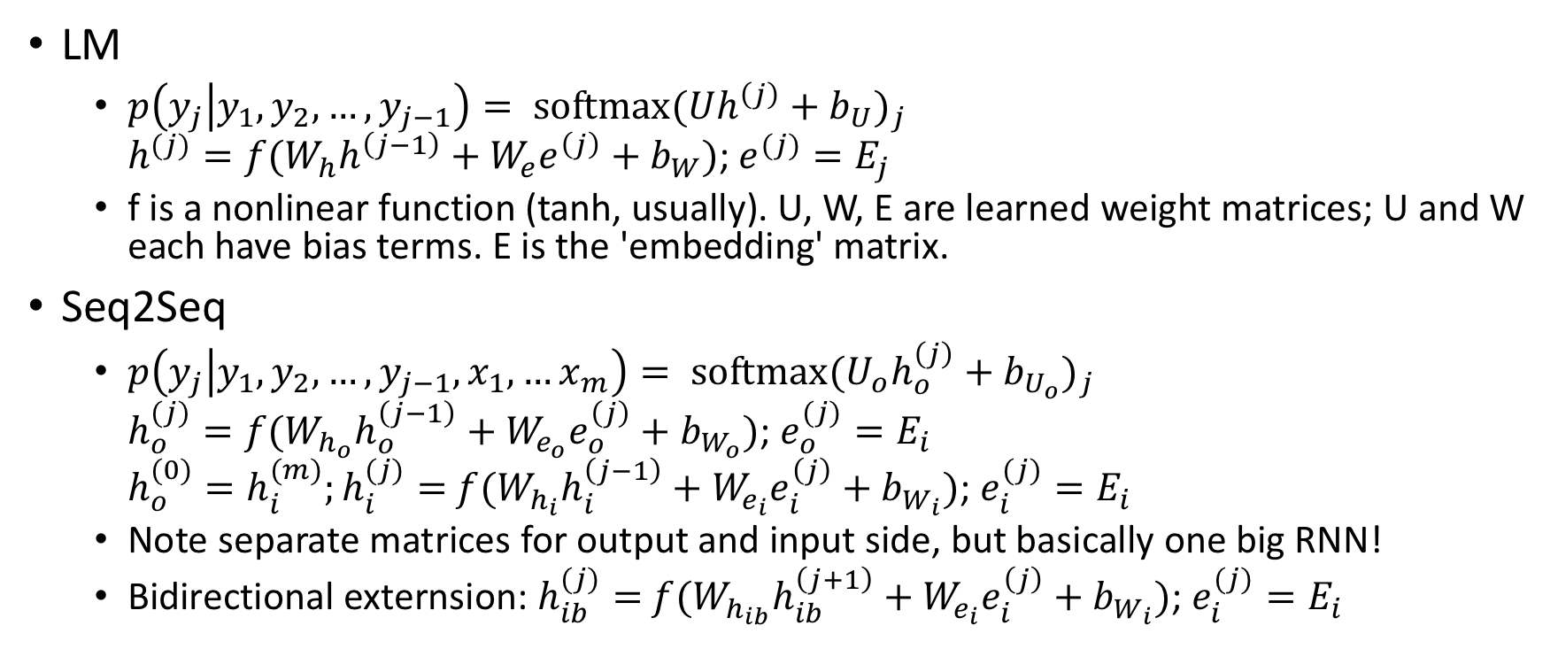
RNN LM vs Seq2Seq, mathematically
LM
$p\left(y_{j} | y_{1},y_{2},…, y_{j−1}\right)= {\text{softmax}(Uh^{\left(j\right)}+b_{U})}_{j}$ $h^{(j)}=f(W_{h}h^{\left(j−1\right)}+W_{e}e^{\left(j\right)}+b_{W})$; $e^{(j)}=E_{j}$
f is a nonlinear function (tanh, usually). U, W, E are learned weight matrices; U and W each have bias terms. E is the 'embedding' matrix.
Seq2Seq
$p\left(y_{j} | y_{1},y_{2},…, y_{j−1},x_{1},…x_{m}\right)= {\text{softmax}(U_{o}h_{o}^{\left(j\right)}+b_{U_{o}})}_{j}$ $h_{o}^{(j)}=f(W_{h_{o}}h_{o}^{\left(j−1\right)}+W_{e_{o}}e_{o}^{\left(j\right)}+b_{W_{o}})$; $e_{o}^{(j)}=E_{i}$ $h_{o}^{(0)}=h_{i}^{(m)};h_{i}^{(j)}=$ $f(W_{h_{i}}h_{i}^{\left(j−1\right)}+W_{e_{i}}e_{i}^{\left(j\right)}+b_{W_{i}})$; $e_{i}^{(j)}=E_{i}$
Note separate matrices for output and input side, but basically one big RNN!
Bidirectional externsion: $h_{ib}^{(j)}=$ $f(W_{h_{ib}}h_{ib}^{\left(j+1\right)}+W_{e_{i}}e_{i}^{\left(j\right)}+b_{W_{i}})$; $e_{i}^{(j)}=E_{i}$

Slide 25
(Multi-level generalization)

Slide 31
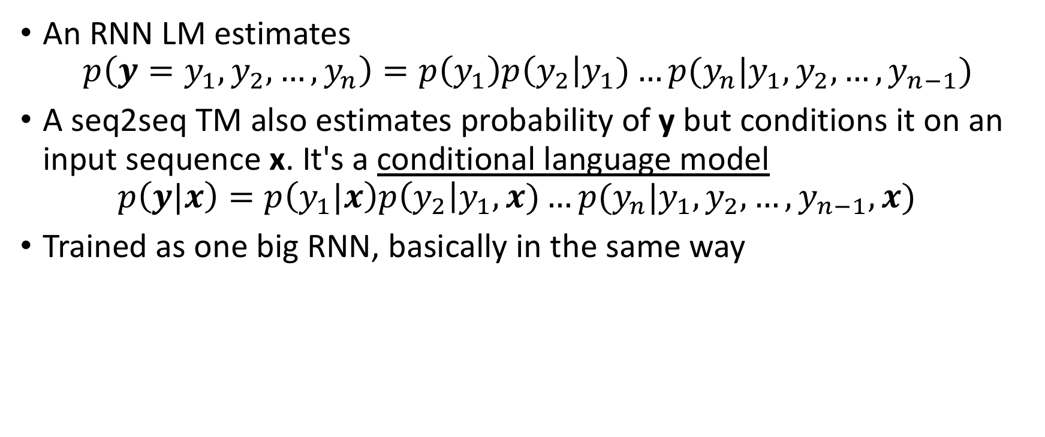
From Language Model to Translation Model
An RNN LM estimates $p\left(y=y_{1},y_{2},…, y_{n}\right)=p\left(y_{1}\right)p\left(y_{2}\right|y_{1})…p(y_{n}|y_{1},y_{2},…, y_{n−1})$
A seq2seq TM also estimates probability of y but conditions it on an input sequence x. It's a conditional language model $p\left(y|x\right)=p\left(y_{1}|x\right)p\left(y_{2}\right|y_{1},x)…p(y_{n}|y_{1},y_{2},…, y_{n−1},x)$
Trained as one big RNN, basically in the same way

Slide 37



Easy To Try Out
github.com/tensorflow/nmt
opennmt.net
(we prefer the pytorch variant)
github.com/EdinburghNLP/nematus
github.com/awslabs/sockeye

Slide 56
Note: in practice there are lots of places attention can go in the networks

Slide 57
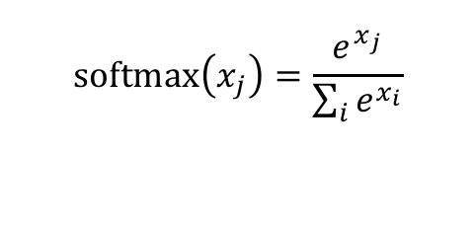
$$\text{softmax}\left(x_{j}\right)=\frac{e^{x_{j}}}{\sum_{i}{e^{x_{i}}}}$$

Slide 59
Neural MT is a fast-evolving area
RNN-free approaches
Character-based models to avoid out-of-vocabulary issues
Unified encoder-decoder for 'zero shot' translation
Translation without parallel data

Slide 63
NMT vs SMT: the good and the bad
Source : ප්‍රවාහන ගාස්තු ඉහළ නැංවීමට විරෝධය පළ කරමින් බ්‍රසීලයේ අද (07) විරෝධතා ක්‍රියාත්මක වුණා.
Ref0 : There were protests in Brazil today (07) due to price increases in transportation.
smt1 : Today (07), Brazil was to protest against the bus fare increase.
smt2 : Staged a protest against transport fares to increase in Brazil, launched a protest today (07th).
smt3 : Transport fare increase in Brazil to protest against the government today the implementation of the protests.
nmt1 : Protests were launched in Brazil today against the increase of transport tariffs.
nmt2 : A protest march was staged in Brazil (07) in Brazil town this morning.
nmt3 : Heavy traffic reported in Brazil
Notes:
Lookup problems in neural machine translations

Slide 64
Challenges
Data size important: NMT needs more data than non-neural SMT before it is competitive
Domain issues: NMT can go spectacularly wrong when domain suddenly shifts
Noise: NMT is more bothered by noisy training data (non-parallel, non-fluent) than non-neural SMT
Evaluation may be fooled by fluency in lieu of adequacy
big chunks of meaning can be skipped; new meaning can be inserted

Slide 67
Solutions to these problems: Use best of both worlds?
Add NMT scores as a feature in SMT
Train NMT to directly predict word alignments
Add coverage vector to NMT to ensure the source is all translated
Train NMT to generate syntax trees with translation
Learn to choose between SMT/NMT output
Allow hand-crafted rules to direct NMT/SMT decoding for certain parts of a translation
...
It's still a wide open field!

Slide 68
Summary
Machine Translation is the oldest NLP application and also one of the most active
Old days: lots of linguistic insight and hand crafted rules
90s: throw away linguistics, rely on corpora and 'pure' models
early 2000s: a bunch of engineering, less 'pure' (discriminative) models
mid 2000s: add linguistics, even more engineering
2014: throw away all that, rely just on data and 'pure' models
2017+: old stuff creeping back in?

